Slide 1
Accessibility at eBay: An Enterprise Success Story
Mark Lapole, Lead Product Mgr, Accessibility, eBay
Beth Crutchfield, VP of Strategic Consulting & Training Svcs
Loren Mikola, Accessibility Consultant
CSUN 2018 Assistive Technology Conference
March 23, 2018

Slide 2

Topics
An Enterprise Success Story
eBay Background and Scale
Areas Critical to Success
Importance of these Success Criteria
Challenges and Approach
The eBay Difference
Q&A
Graphic: PixaBay

Slide 3
eBay Background and Scale

Slide 4









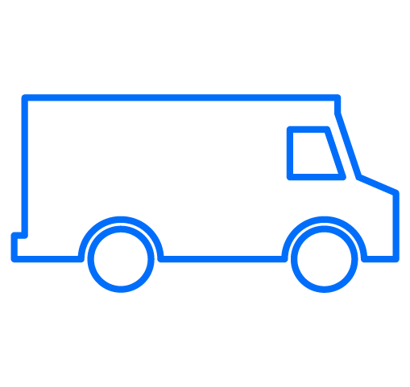

Our Business
eBay Background & Scale
Money Back Guarantee
List
Browse
Feedback
Marketplace
Connect
Receive or Pick-Up
Transact
Shipping
Give Back

Slide 5










eBay Inc. at a Glance
eBay Background & Scale
$2.4B
168M
$11B
Revenue
Global active buyers
Mobile volume
57%
380M
$21.7B
International revenue
App downloads
GMV
Data as of Q3 2017

Slide 6





eBay Marketplace at a Glance
eBay Background & Scale
$20.5B
1.1B
81%
GMV
Live listings
Items sold as new
69%
12.4M
61%
Transactions that ship
For free (US, UK, DE)
New listings added via mobile per week
Platform GMV touched by mobile
Data as of Q3 2017

Slide 7




eBay Background & Scale
2017 Fun Facts: Velocity Stats by Region - Mobile
US
UK
A pair of women’s shoes is purchased every
8 sec
A cookware item is purchased every
5 sec
A car or truck is purchased every
3 min
A tablet is purchased every
14 sec
An action figure is purchased every
13 sec
A car is purchased every
2 min
DE
AU
A tire or car part is purchased every
24 sec
A jewelry item is purchased every
14 sec
A tablet is purchased every
10 sec
A baby clothing item is purchased every
50 sec
A book is purchased every
14 sec
A car or truck part is purchased every
9 sec

Slide 8
Critical Areas to Success

Slide 9

Areas Critical to Success
Clearly-defined roles
PM, Design, Dev, QA
Core components
eBay MIND
Automated and manual testing
aXe, color, keyboard, screen reader
Process inclusion
Where, when, and whom
Notes:
Small team, who’s responsible for what… where are your expertise. Clear, consistent message from the team.
Set of commonly used components, found across the site, built with a11y in mind. Point to during reviews, efficient for front-end dev. Examples…
Automated testing what you can, no false positives, provide guidance. Require manual testing (color contrast, keyboard, screen reader)
Find places to inject yourself. Where can teams (ultimately your product and customers) benefit from accessibility review? What processes exist that make sense for you to be part of?

Slide 10
Importance of These Success Criteria

Slide 11
Overview of DAMMTM
Digital Accessibility Maturity Model™ (DAMM™)
Digital Accessibility Maturity Model™ (DAMM™)
Developed by Level Access (formerly known as SSB BART Group)
Help companies assess digital accessibility program maturity along a series of dimensions and aspects
Can be used across all industries and types of organizations
DAMM™ leverages successful practices and is aligned to maturity-model based approaches
CMU SEI original work in Capability Maturity Models (CMM)
Business Disability Forum’s Accessibility Maturity Model
NASCIO Policy-Driven Adoption for Accessibility
levelaccess.com | (800) 899-9659 | info@levelaccess.com

Slide 12
Five Levels of Maturity
Digital Accessibility Maturity Model™ (DAMM™)
Level Access
Digital Accessibility Maturity Model™
(DAMM™)
Level 5
Optimizing
Continually optimizing accessibility processes
Level 4
Managed
Actively managing, controlling standard accessibility processes
Level 3
Defined
Using standard, documented processes for accessibility across the organization
Encouraging discipline and increasing the repeatability of accessibility processes
Level 2 Repeatable
Level 1
Initial
Performing accessibility activities in an ad hoc, uncontrolled and reactive manner
12
levelaccess.com | (800) 899-9659 | info@levelaccess.com
Notes:
The model provides a theoretical continuum along which process maturity can be developed incrementally from one level to the next. Skipping levels is not allowed/feasible.
Level 1 - Initial (Chaotic)
It is characteristic of processes at this level that they are (typically) undocumented and in a state of dynamic change, tending to be driven in an ad hoc, uncontrolled and reactive manner by users or events. This provides a chaotic or unstable environment for the processes.
Level 2 - Repeatable
It is characteristic of processes at this level that some processes are repeatable, possibly with consistent results. Process discipline is unlikely to be rigorous, but where it exists it may help to ensure that existing processes are maintained during times of stress.
Level 3 - Defined
It is characteristic of processes at this level that there are sets of defined and documented standard processes established and subject to some degree of improvement over time. These standard processes are in place (i.e., they are the AS-IS processes) and used to establish consistency of process performance across the organization.
Level 4 - Managed
It is characteristic of processes at this level that, using process metrics, management can effectively control the AS-IS process (e.g., for software development ). In particular, management can identify ways to adjust and adapt the process to particular projects without measurable losses of quality or deviations from specifications. Process Capability is established from this level.
Level 5 - Optimizing
It is a characteristic of processes at this level that the focus is on continually improving process performance through both incremental and innovative technological changes/improvements. At maturity level 5, processes are concerned with addressing statistical common causes of process variation and changing the process (for example, to shift the mean of the process performance) to improve process performance. This would be done at the same time as maintaining the likelihood of achieving the established quantitative process-improvement objectives. There are only a few companies in the world that have attained this level 5.
IMPORTANT NOTES:
In order to reach the next level, you must have met all the requirements of the previous level
Anyone can be level 1, if they are trying in some way shape or form to implement accessibility
To get to level 2, you have to have some policies, standards and processes defined, but not everyone is using them in a consistent way
To get to level 3, the processes need to be implemented across the entire organization
Level 4 focuses on metrics – do you have reports that are telling you what you are doing and what the trends are
Level 5 is all about process improvement
A centralized Accessibility Program Office (APO) is mandatory to get past 3 or in some dimensions, level 2. SSB is unaware of organizations that have successfully implemented mature accessibility processes without an APO. It doesn’t need to be called “APO”, it just needs to perform as a centralized “the buck stops here” function for all questions related to accessibility.

Slide 13
Dimensions to Measure Maturity at eBay
Digital Accessibility Maturity Model™ (DAMM™)
Governance, Risk Management, and Compliance
Communications
Policy and Standards
Legal
Fiscal Management
Development Lifecycle
Testing and Validation
Support and Documentation*
Procurement*
Training
* Items not evaluated
levelaccess.com | (800) 899-9659 | info@levelaccess.com

Slide 14
eBay DAMMTM Audit Snapshot
Governance, Risk Management and Compliance | Communications | Policies and Standards | Legal | Fiscal Management | Development Lifecycle | Testing and Validation | Support and Documentation | Procurement | Training
levelaccess.com | (800) 899-9659 | info@levelaccess.com

Slide 15
Challenges and Approach

Slide 16

Common Challenges
And our Approach at eBay
Leadership support
Getting from ”why” to “how”
Training and awareness
Role-specific sessions, find your way into meetings
Getting word out
Internal and external communications
Include people with disabilities in testing
Usability testing, require product team

Slide 17

Recap
Components of a successful A11Y program
Leadership support
Training and awareness
Spreading the word
Include people with disabilities in testing
Clearly define roles
Core components
Automated and manual testing
Process inclusion

Slide 18
The eBay Difference

Slide 19
The eBay Difference
Some things that make eBay unique
DAMM Score – 4
Accessibility Champions
Dev and testing tools
Definition of Done inclusion
MIND Patterns – http://ebay.github.io/mindpatterns/
OATMEAL – Open Accessibility Testing Methods for Experts And Layfolk

Slide 20
eBay Global Impact
www.ebayinc.com/global-impact
Opportunity for All
We enable everyone to participate in and benefit from global commerce.
Circular Economy
We give products a chance to have many lives and serve many people.
eBay for Charity
We help buyers and sellers support causes they care about.
levelaccess.com | (800) 899-9659 | info@levelaccess.com

Slide 21
Thank You and Resources

Slide 22

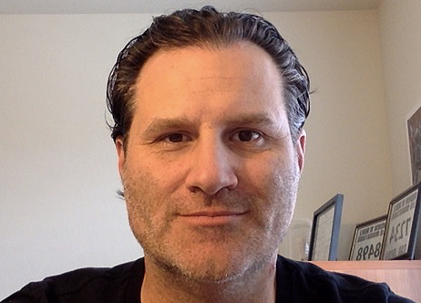
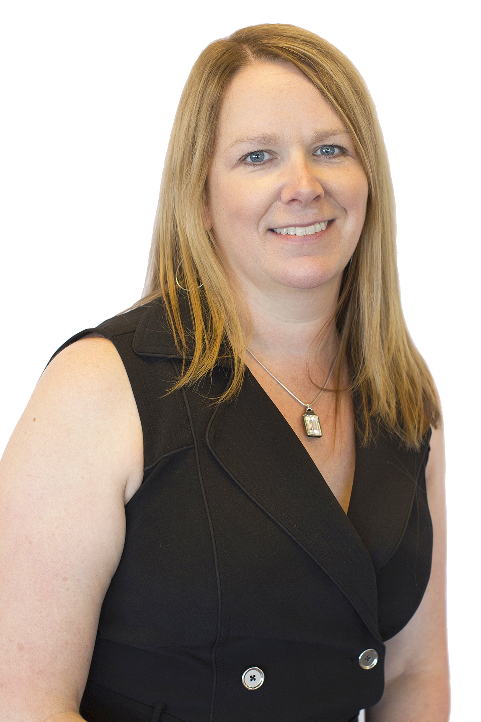
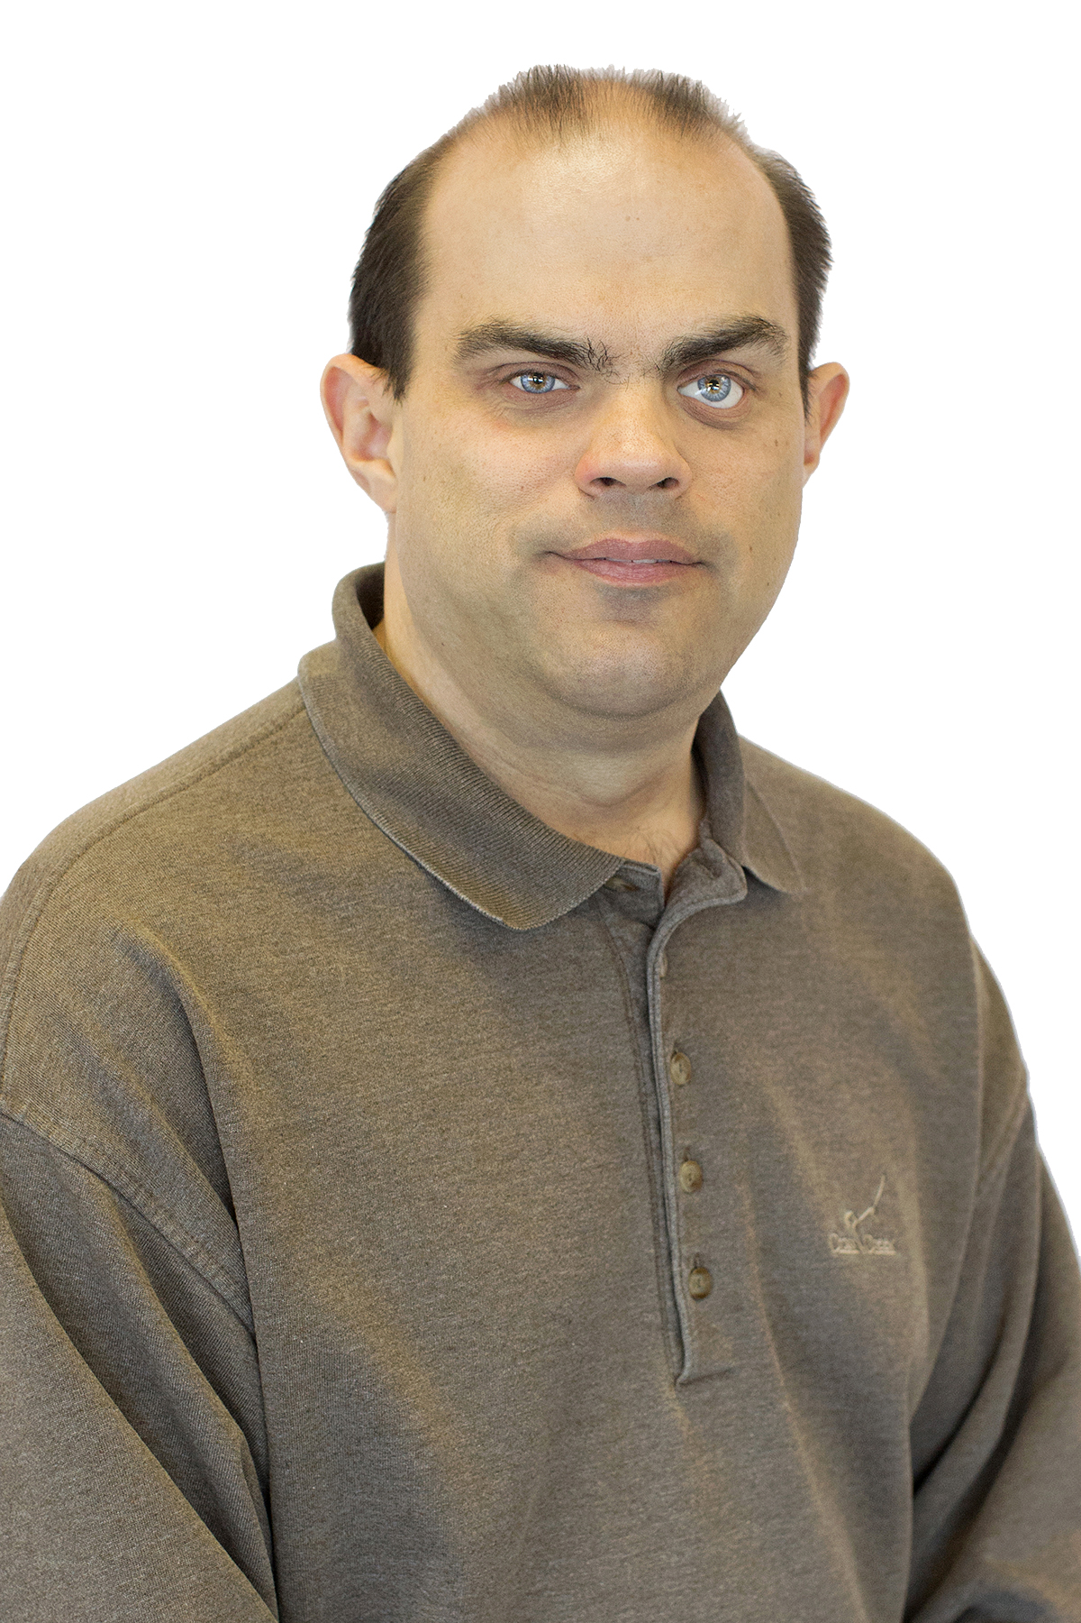
Thank You!
Mark Lapole, Lead PM, Accessibility mlapole@ebay.com
Beth Crutchfield, VP, Strategic Consulting and Training Services beth.crutchfield@levelaccess.com
Loren Mikola, Accessibility Consultant loren.mikola@levelaccess.com
levelaccess.com | (800) 899-9659 | info@levelaccess.com

Slide 23




Resources
Contact Us
Level Access
(800) 889-9659
info@levelaccess.com
Follow Us
@LevelAccessA11y
@eBay
Level Access
eBay
Level Access
eBay
Level Access Blog
Slide Deck Available for Download at: https://www.levelaccess.com/csun18/

